Slide 1


<Name>
<Date>

Slide 2

Outline
Executive Summary
Introduction
Methodology
Results
Conclusion
Appendix

Slide 3
Executive Summary
Summary of using methodologies
Data Collection using with a SpaceX API and web scraping
Exploratory Data Analysis with data wrangling and search database
data visualization and create interactive map
Machine Learning Prediction
Summary of all results
Possible to collected valuable data from public sources
Exploratory Data Analysis is possible to identify which features are the be to better predict success of launchings
Use machine Learning predictions showed the success or failure of the launch can be predicted

Slide 4
Introduction
Project background and context
In the space industry, where governments have traditionally played a key role, there is now more room for private companies to enter the field
Problems you want to find answers
Analyze the results of SpaceX, the company that has already taken the lead, to determine whether or not they will be able to enter the field

Slide 5

Section 1

Slide 6
Methodology
Executive Summary
Data collection methodology: Get data from the following sources:
Get SpaceX launch data from API
Get web scraping data from wikipedia
Perform data wrangling
Data obtained from API or the web is formatted using the following processes:
Data validation
Feature selection
Missing value handling
Replace categorical data with numeric values

Slide 7
Methodology
Executive Summary
Perform exploratory data analysis (EDA) using visualization and SQL
Aggregate data by axes such as “Launch Site" and "Landing Outcome" to understand the overall trend of the data
Perform interactive visual analytics using Folium and Plotly Dash
Marking launch sites on maps using Folium
Visualizing quantitative information using Dash

Slide 8
Methodology
Executive Summary
Perform predictive analysis using classification models
How to build, tune, evaluate classification models
Cast the target variable to a numeric type
Normalize features
Construct a predictive model using the following techniques:
Logistic Regulation
Decision Tree
SVM
KNN

Slide 9
Data Collection
Data source
SpaceX API(JSON)
https://api.spacexdata.com/v4/launches/past
Wikipedia(Scraping WEB)
https://en.wikipedia.org/w/index.php?title=List_of_Falcon_9_and_Falcon_Heavy_launches

Slide 10
Data Collection – SpaceX API
Request the API provided by SpaceX to obtain JSON format data
Parse the JSON format data and convert it to a Data Frame
Complete missing values ​​and extract Falcon 9 data
Get JSON
conversion to dataframe
Filter the data to only Falcon 9
Dealing with Missing Values
SpaceX API calls notebook (https://github.com/nekonabesan/IBM_DataScience/blob/main/Capstone/jupyter-labs-spacex-data-collection-api.ipynb)

Slide 11
Data Collection - Scraping
Request the "Falcon9 Launch" page on Wikipedia and get the HTML
Extract all column and variable names from the HTML table header
convert to data frame by parsing the launch HTML tables
Get HTML from wiki
Extracting a table from the DOM
Convert table to dictionary
Convert dictionary to Data Frame
Web scraping notebook (https://github.com/nekonabesan/IBM_DataScience/blob/main/Capstone/jupyter-labs-webscraping.ipynb)

Slide 12
Data Wrangling
Count
the data
Counting the number of launches per launch site
Counting the number of launches per target orbit
Counting the success or failure of missions per target orbit
Create a landing outcome label from Outcome column
number of launches per launch site
number of launches per target orbit
success or failure of missions per target orbit
Create label from Outcome column
Data wrangling notebook (https://github.com/nekonabesan/IBM_DataScience/blob/main/Capstone/labs-jupyter-spacex-Data%20wrangling.ipynb)

Slide 13
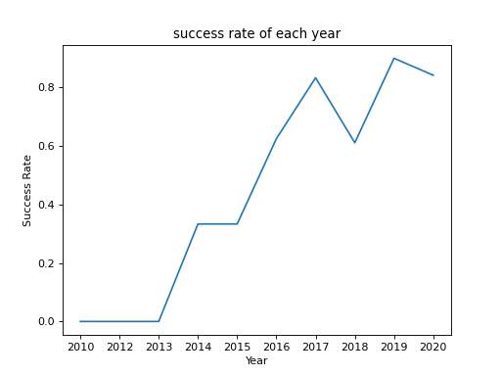
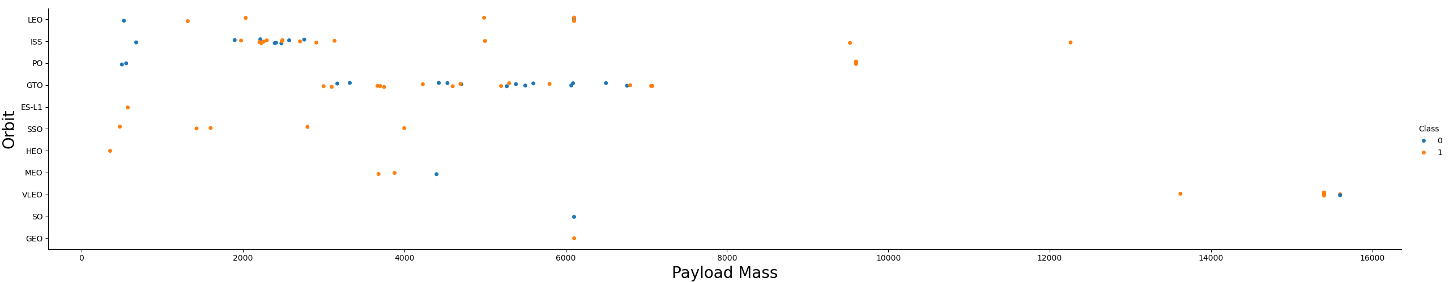
EDA with Data Visualization
Visualize and compare relationships between features such as "Launch Site", "Payload Mass", and "Orbit Type”
Finally, visualize the annual launch success rate
EDA with data visualization notebook (https://x.gd/FdBSn)

Slide 14
EDA with SQL
List and visualize some numbers from launch data
Create List the records which will display the month names, failure landing_outcomes in drone ship ,booster versions, launch_site for the months in year of 2015
Caluculate Rank the count of landing outcomes such as Failure or Success between the date 2010-06-04 and 2017-03-20
EDA with data visualization notebook (https://x.gd/UzWQt)
Visualize
the data
relationship between Flight Number and Launch Site
relationship between Payload Mass and Launch Site
relationship between success rate of each orbit type
relationship between Flight Number and Orbit type
relationship between Payload Mass and Orbit type
launch success yearly trend
Features Engineering
Create dummy variables to categorical columns

Slide 15
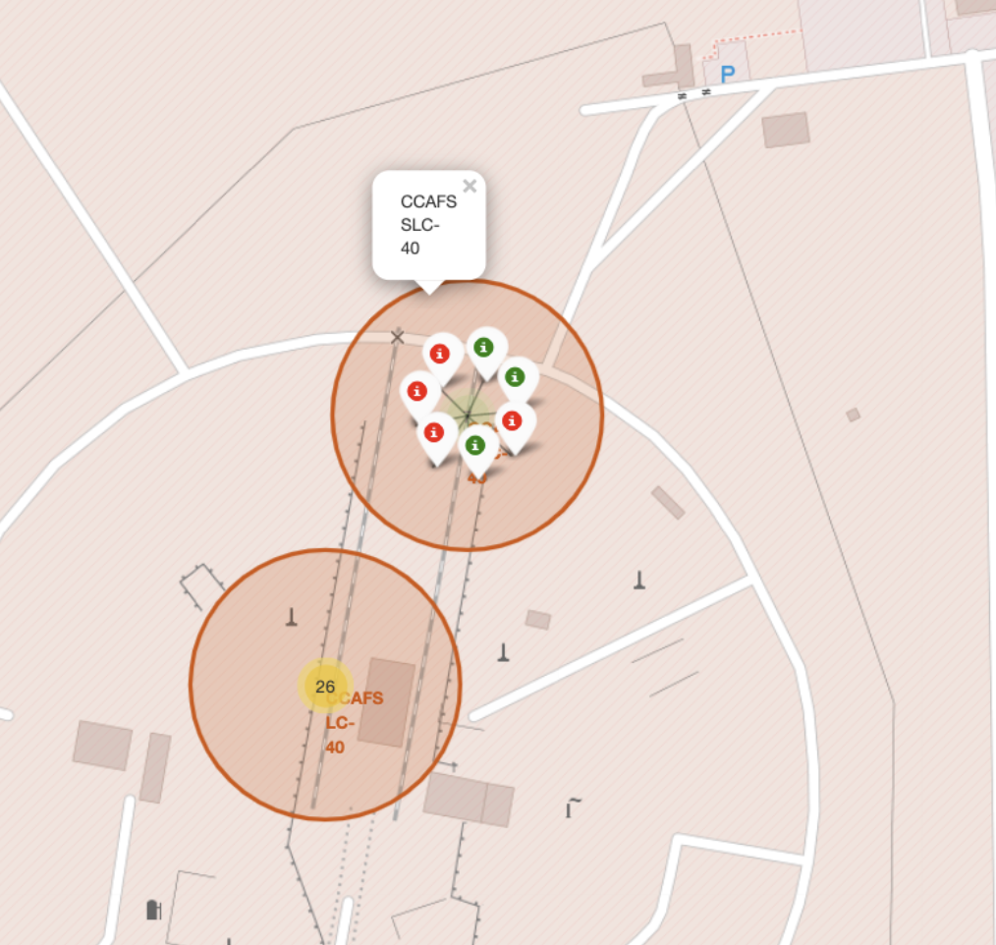
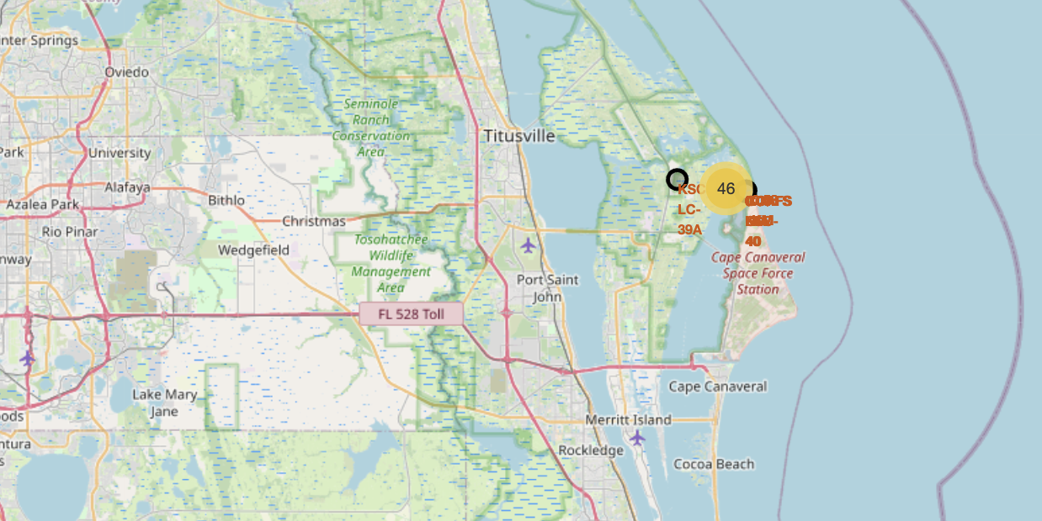
Build an Interactive Map with Folium
Mark information
On map
Mark all launch sites on a map
Mark all launch sites on a map with use folium circle
Mark the success or failed launches for each site on the map
Calculate the distances between a launch site to its proximities
Visualize the distance between the launch site and major roads or urban areas on a map and analyze the location
Mark the success or failed launches
Calculate the distances
Analize location
Analyze the location
create interactive map notebook (https://github.com/nekonabesan/IBM_DataScience/blob/main/Capstone/lab_jupyter_launch_site_location.ipynbß)

Slide 16
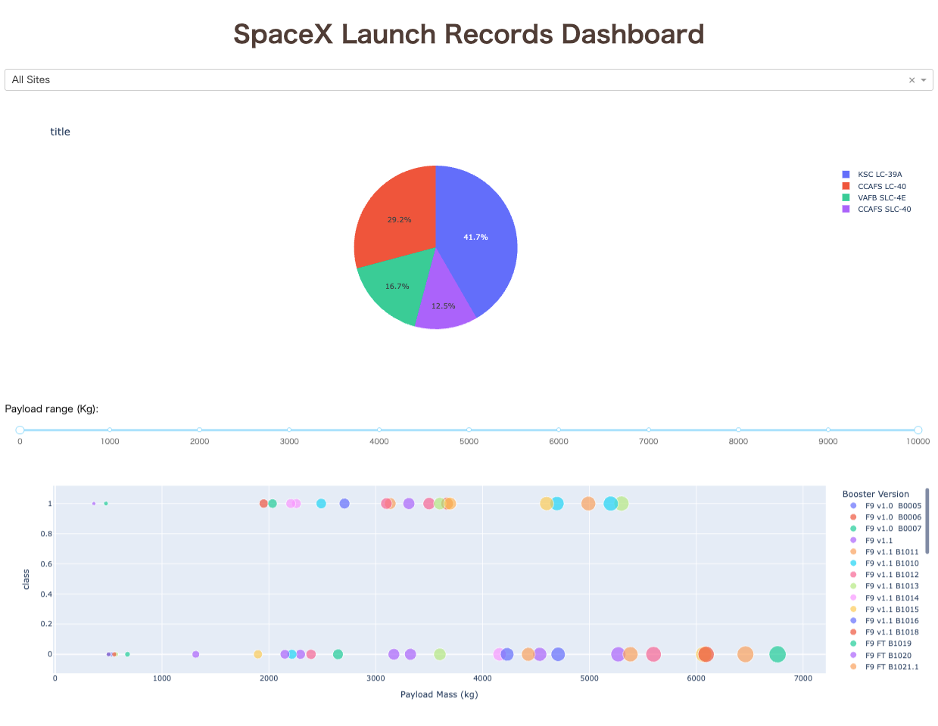
Build a Dashboard with Plotly Dash
Implementation a dropdown list to enable Launch Site selection, In addition to that Implement a callback function associated with the list selection state
Implementation a pie chart to show the total successful launches count for all sites, If a specific launch site was selected, show the Success vs. Failed counts for the site
Implementation a slider to select payload range slider, and Implementation callback function with Linked to slider action
create Dash app script (https://github.com/nekonabesan/IBM_DataScience/blob/main/Capstone/spacex-dash-app.py)

Slide 17
Predictive Analysis (Classification)
Summarize how you built, evaluated, improved, and found the best performing classification model
Prepare and standardize the data, in addition to that the data set split training and test data.
Training a model and alculate the accuracy on the test data using the method score:
Data preparation
Data standardization
Search and combinations of hyperparameters
Laern and test of each model
Comparison of results
create Dash app script (https://github.com/nekonabesan/IBM_DataScience/blob/main/Capstone/SpaceX_Machine%20Learning%20Prediction_Part_5.ipynb)

Slide 18
Results
Summary of exploratory data analysis results
SpaceX conducted 90 launches from four launch sites between 2010 and 2020, with a success rate of just under 67%.
The orbit types with the highest success rates are SSO, HEO, GEO, and ES-L1.
From 2013 to 2020, launch success rates have consistently increased.

Slide 19
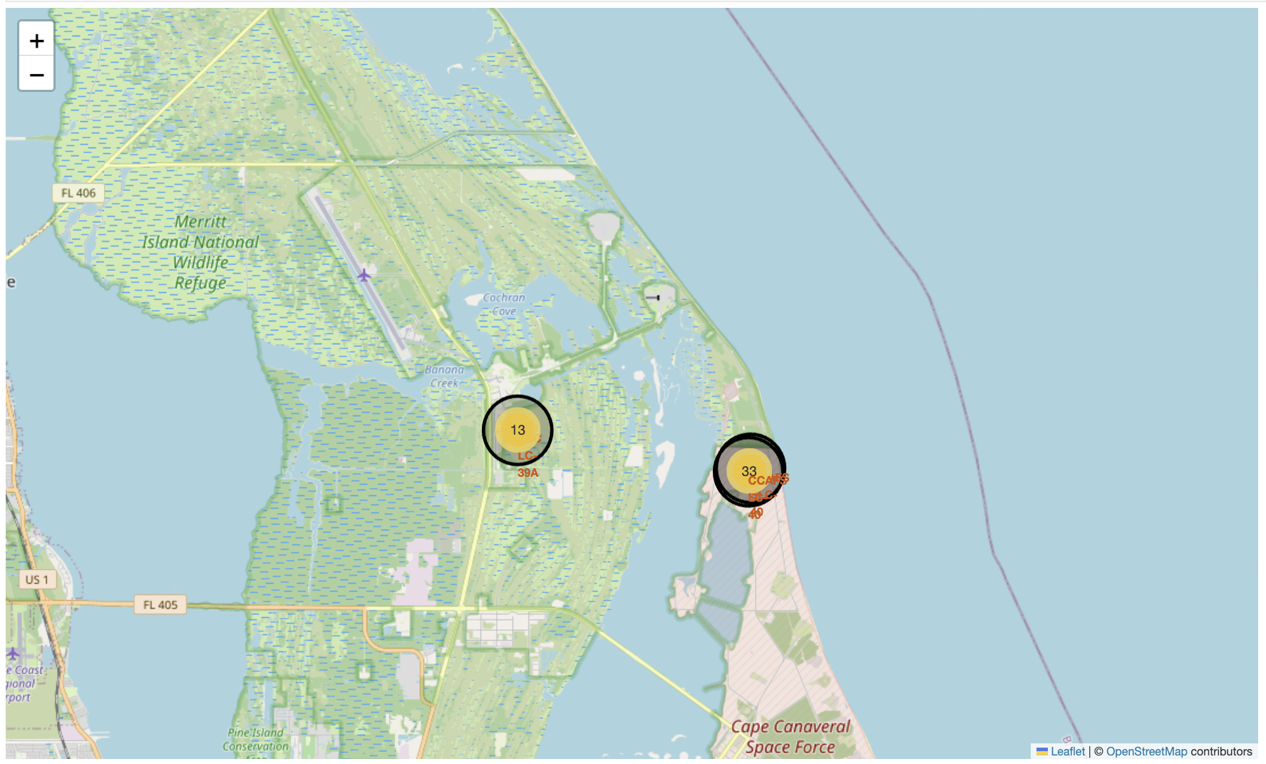
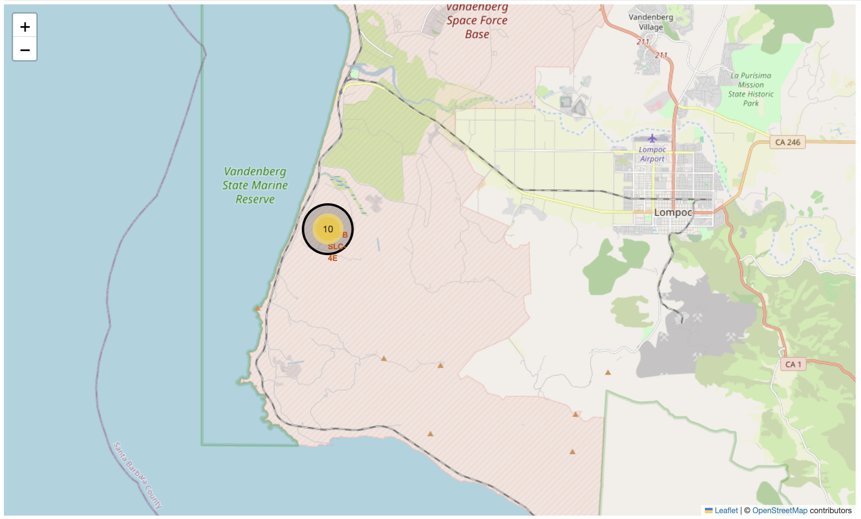
Results
Interactive analytics of launch site location
The launches were carried out from the following facilities:
CCAFS LC-40 (Florida)
CCAFS SLC-40(Florida)
KSC LC 39A(Florida)
VAFB SLC-4E(Santa Barbara County CA)
The launch site is located next to the coast and in the southern United States, relatively close to the equator

Slide 20
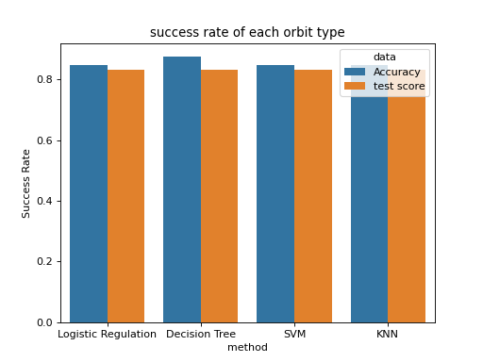
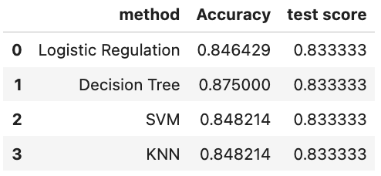
Results
Predictive analysis results
Construct a predictive model using four methods
Logistic Regulation
Decision Tree
SVM
KNN
The amount of data was small, so there was no significant difference in the results.

Slide 21

Section 2

Slide 22
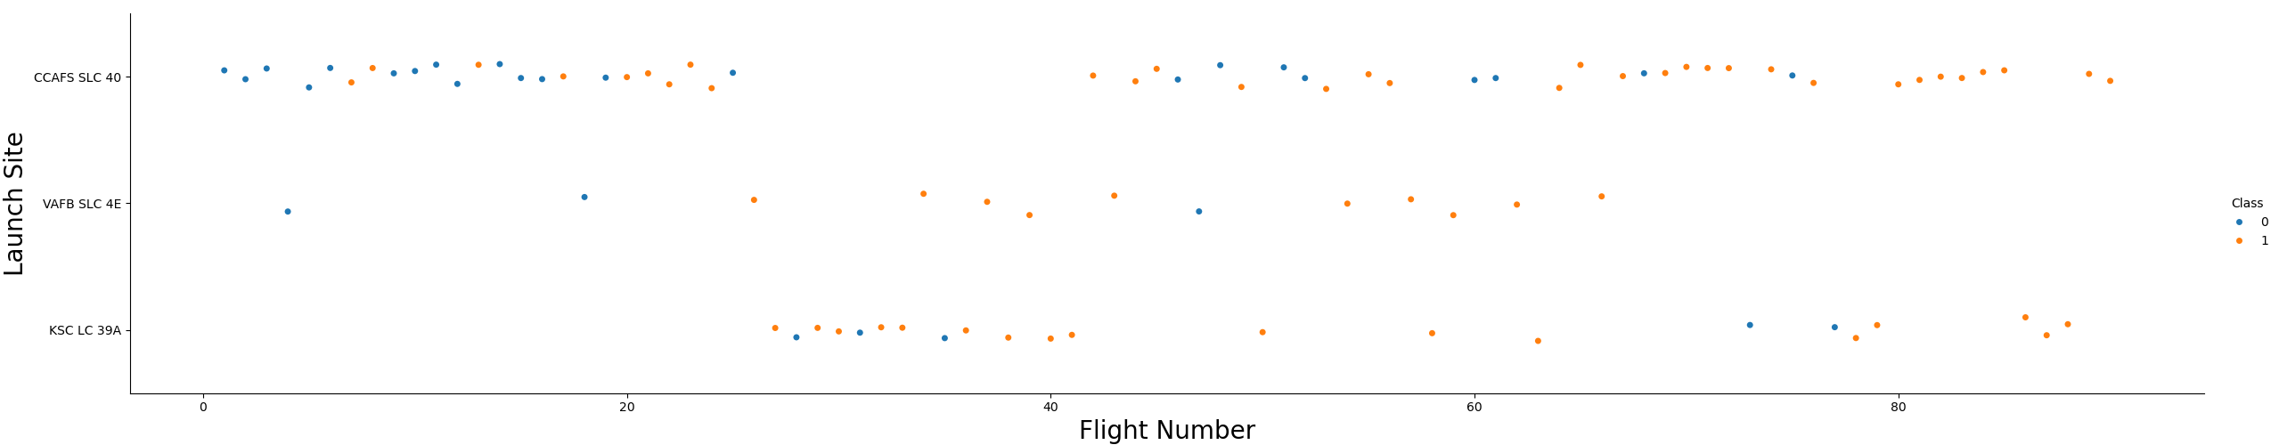
Flight Number vs. Launch Site
The launch site with the most attempts is CCAF5 SLC 40.
The launch site with the highest success rate is CCAF5 SLC 40
Success rate is improving over time

Slide 23
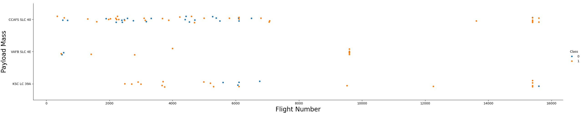
Payload vs. Launch Site
The positive efficiency improves as the payload increases
The above is thought to be due to the payload being increased as the booster matures

Slide 24
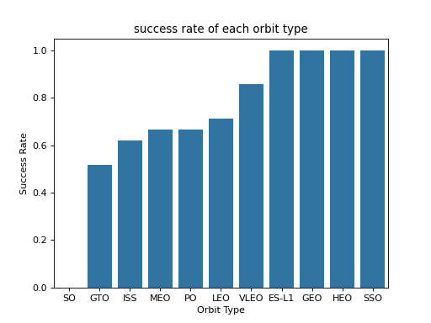
Success Rate vs. Orbit Type
The most successful orbit types are:
SSO
HEO
GEO
ES-L1

Slide 25
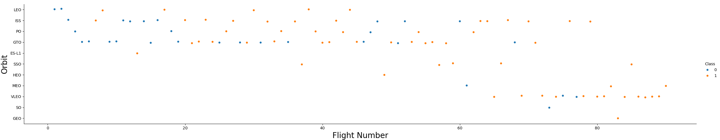
Flight Number vs. Orbit Type
Regardless of orbit type, orbit insertion success rates have improved over time

Slide 26
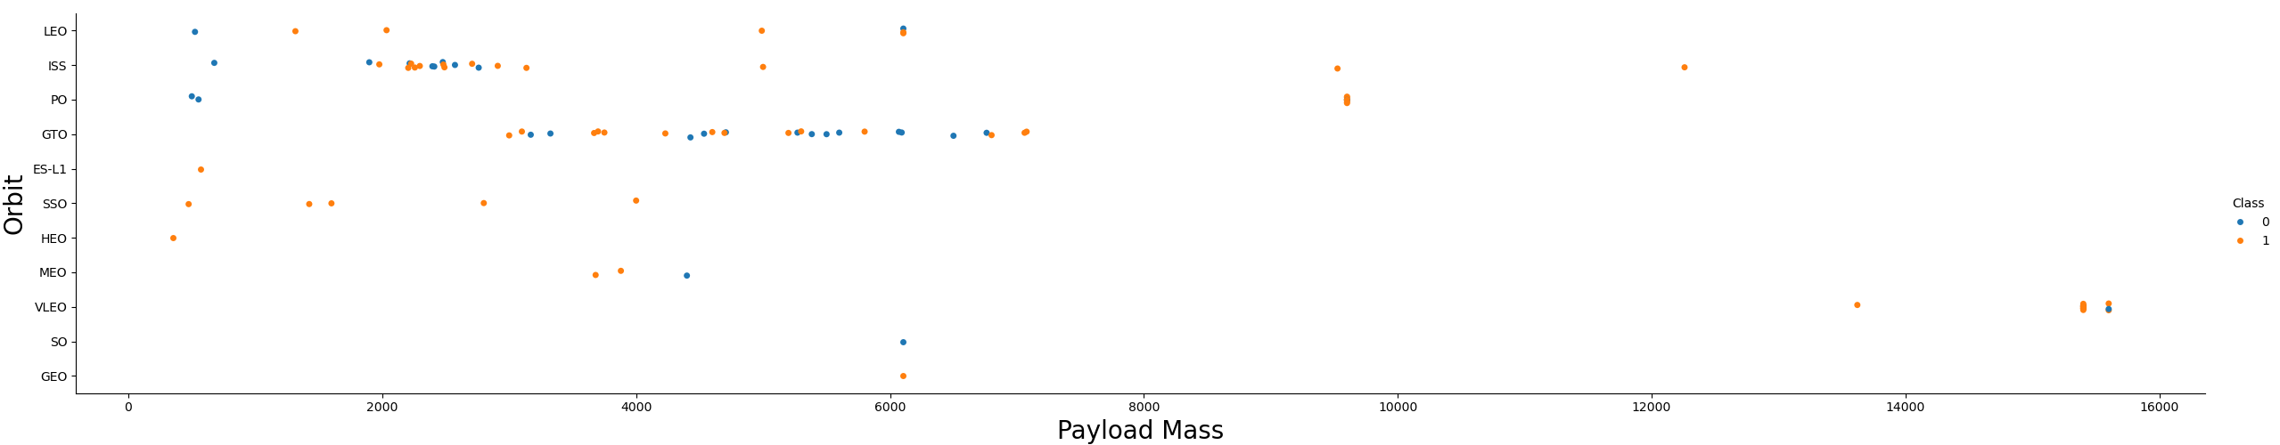
Payload vs. Orbit Type
Looking at the GTO and ISS orbits, which have been tried many times, there is no clear difference in success rate between orbit types and payload axes

Slide 27
Launch Success Yearly Trend
The overall success rate of launches is improving year by year.

Slide 28
All Launch Site Names
Names of the unique launch sites
query result
Launch_Site
CCAFS LC-40
CCAFS SLC-40
KSC LC-39A
VAFB SLC-4E
SELECT `Launch_Site` FROM SPACEXTBL GROUP BY `Launch_Site`

Slide 29
Launch Site Names Begin with 'CCA'
5 records where launch sites begin with `CCA`
Extracted to launch data of Cape Canaveral Space Launch Complex Sites
Date | Time (UTC) | Booster_Version | Launch_Site | Payload | PAYLOAD_MASS__KG_ | Orbit | Customer | Mission_Outcome | Landing_Outcome
2010-06-04 | 18:45:00 | F9 v1.0 B0003 | CCAFS LC-40 | Dragon Spacecraft Qualification Unit | 0 | LEO | SpaceX | Success | Failure (parachute)
2010-12-08 | 15:43:00 | F9 v1.0 B0004 | CCAFS LC-40 | Dragon demo flight C1, two CubeSats, barrel of Brouere cheese | 0 | LEO (ISS) | NASA (COTS) NRO | Success | Failure (parachute)
2012-05-22 | 7:44:00 | F9 v1.0 B0005 | CCAFS LC-40 | Dragon demo flight C2 | 525 | LEO (ISS) | NASA (COTS) | Success | No attempt
2012-10-08 | 0:35:00 | F9 v1.0 B0006 | CCAFS LC-40 | SpaceX CRS-1 | 500 | LEO (ISS) | NASA (CRS) | Success | No attempt
2013-03-01 | 15:10:00 | F9 v1.0 B0007 | CCAFS LC-40 | SpaceX CRS-2 | 677 | LEO (ISS) | NASA (CRS) | Success | No attempt
SELECT * FROM SPACEXTBL WHERE `Launch_Site` LIKE 'CCA%' LIMIT 5

Slide 30
Total Payload Mass
total payload mass carried by boosters launched by NASA (CRS)
Extract from `Booster_Version` column with WHERE clause
total payload mass[kg]
48213
SELECT SUM(`PAYLOAD_MASS__KG_`) AS `total payload mass[kg]`
FROM SPACEXTBL WHERE `Customer` LIKE '%NASA (CRS)%'

Slide 31
Average Payload Mass by F9 v1.1
Average payload mass carried by booster version F9 v1.1
query result with a short explanation here
payload mass[kg]
2928.4
SELECT AVG(`PAYLOAD_MASS__KG_`) AS `payload mass[kg]` FROM SPACEXTBL WHERE `Booster_Version` = 'F9 v1.1'

Slide 32
First Successful Ground Landing Date
First successful landing outcome on ground pad
`Date` Sort in ascending order and filter by LIMIT clause
first succesful date
2015-12-22
SELECT `Date` AS `first succesful date` FROM SPACEXTBL
WHERE `Landing_Outcome` = 'Success (ground pad)' ORDER BY `Date` ASC LIMIT 1

Slide 33
Successful Drone Ship Landing with Payload between 4000 and 6000
List the names of boosters which have successfully landed on drone ship and had payload mass greater than 4000 but less than 6000
Present your query result with a short explanation here
Booster Version
F9 FT B1022
F9 FT B1026
F9 FT B1021.2
F9 FT B1031.2
SELECT `Booster_Version` AS `Booster Version` FROM SPACEXTBL
WHERE `Landing_Outcome` = 'Success (drone ship)’
AND (`PAYLOAD_MASS__KG_` >= 4000 AND `PAYLOAD_MASS__KG_` <= 6000)

Slide 34
Total Number of Successful and Failure Mission Outcomes
Calculate the total number of successful and failure mission outcomes
GROUP BY with `Outcome` and use CASE statement to separate cases
Outcome | counts
Failure | 1
Success | 100
SELECT
CASE
WHEN `Mission_Outcome` LIKE '%Success%' THEN 'Success'
ELSE 'Failure'
END AS `Outcome`
,COUNT(`Mission_Outcome`) AS `counts`
FROM SPACEXTBL GROUP BY `Outcome`

Slide 35
Boosters Carried Maximum Payload
List the names of the booster which have carried the maximum payload mass
Specify the list obtained by the subquery as the IN condition
Booster_Version | MAX_PAYLOAD
F9 B5 B1048.4 | 15600
F9 B5 B1048.5 | 15600
F9 B5 B1049.4 | 15600
F9 B5 B1049.5 | 15600
F9 B5 B1049.7 | 15600
F9 B5 B1051.3 | 15600
F9 B5 B1051.4 | 15600
F9 B5 B1051.6 | 15600
F9 B5 B1056.4 | 15600
F9 B5 B1058.3 | 15600
F9 B5 B1060.2 | 15600
F9 B5 B1060.3 | 15600
SELECT `Booster_Version`,`PAYLOAD_MASS__KG_` AS `MAX_PAYLOAD` FROM SPACEXTBL AS TBL1
WHERE `MAX_PAYLOAD` IN (SELECT MAX(`PAYLOAD_MASS__KG_`) AS `MAX_PAYLOAD` FROM SPACEXTBL AS TBL2)
GROUP BY `Booster_Version`
ORDER BY `Booster_Version`

Slide 36
2015 Launch Records
List the failed landing_outcomes in drone ship, their booster versions, and launch site names for in year 2015
SELECT SPACEXTBL and edit `Date` column
month | Landing_Outcome | Booster_Version | Launch_Site
01 | Failure (drone ship) | F9 v1.1 B1012 | CCAFS LC-40
04 | Failure (drone ship) | F9 v1.1 B1015 | CCAFS LC-40
SELECT
substr(Date, 6,2) AS `month`
,`Landing_Outcome`
,`Booster_Version`
,`Launch_Site`
FROM SPACEXTBL
WHERE substr(Date,0,5)='2015' AND `Landing_Outcome` = 'Failure (drone ship)'

Slide 37
Rank Landing Outcomes Between 2010-06-04 and 2017-03-20
Rank the count of landing outcomes between the date 2010-06-04 and 2017-03-20
SELECT SPACEXTBL and sort `count` as DESC
count | Landing_Outcome
10 | No attempt
5 | Success (drone ship)
5 | Failure (drone ship)
3 | Success (ground pad)
3 | Controlled (ocean)
2 | Uncontrolled (ocean)
2 | Failure (parachute)
1 | Precluded (drone ship)
SELECT
COUNT(*) AS `count`
,`Landing_Outcome`
FROM SPACEXTBL
WHERE `Date` >= '2010-06-04' AND '2017-03-20' >= `Date`
GROUP BY `Landing_Outcome`
ORDER BY `count` DESC

Slide 38

Section 3

Slide 39
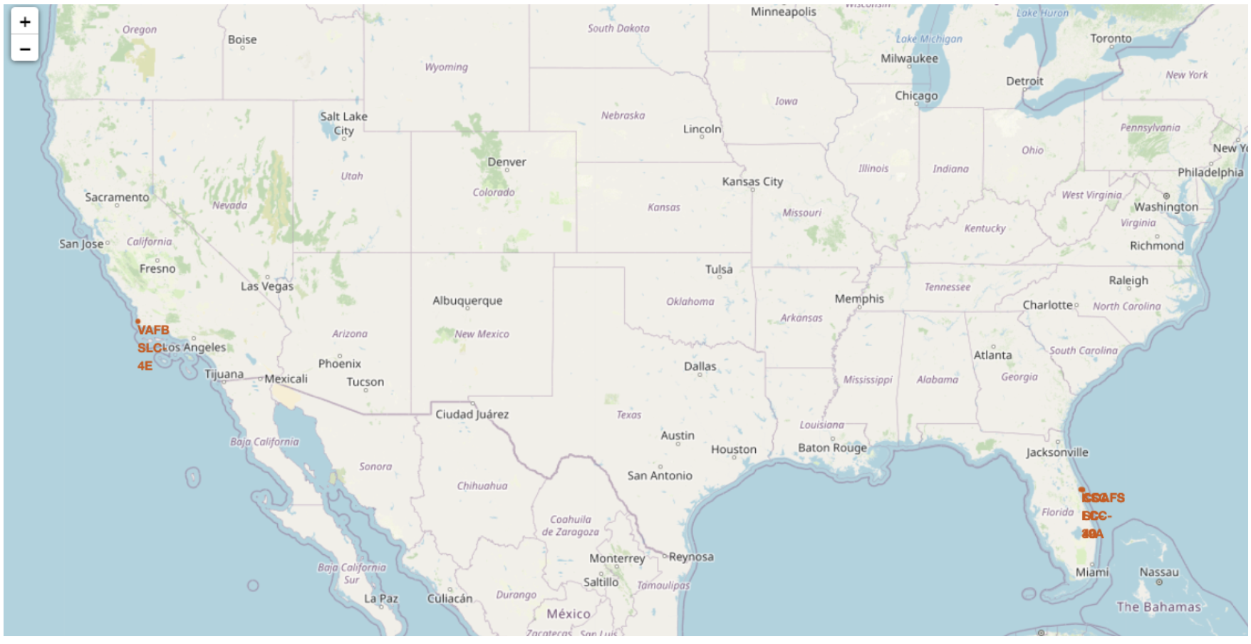
Drawing launch sites on folium map
Folium map on Launch site location
Four launch sites are marked on the map.
The launch site is located in the most favorable location in the United States for orbital launch.

Slide 40
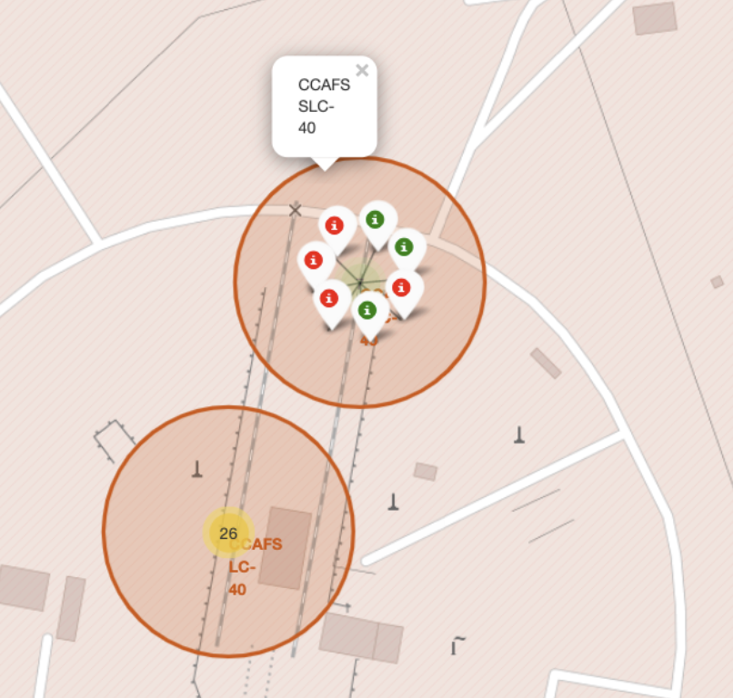
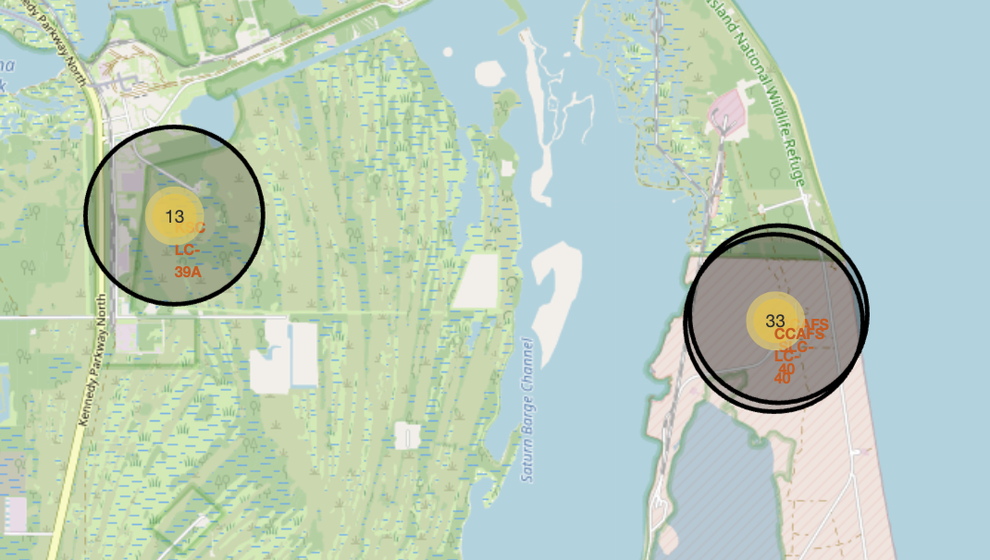
Launch Outcomes on Sites
success or failure of each launch outcome on draw folium map

Slide 41
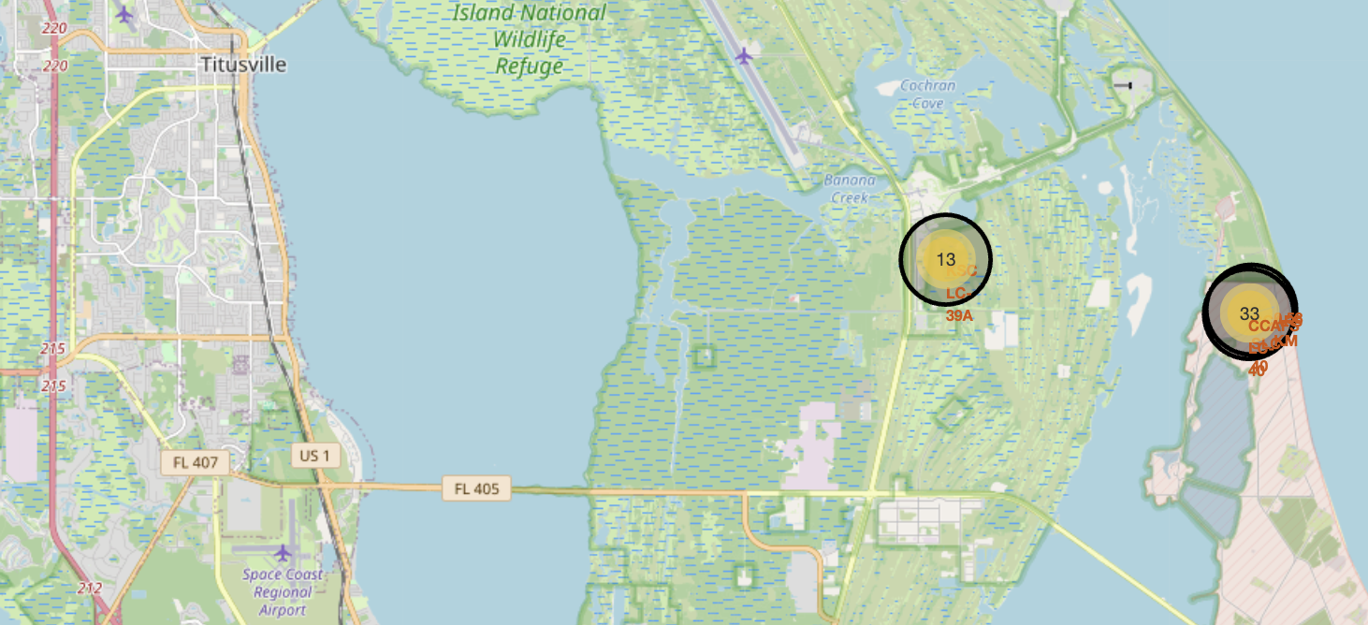
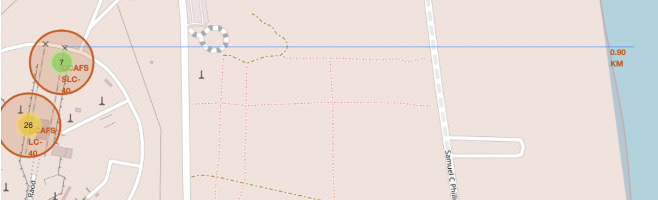
Location and environment of launch sites
Visualize the relationship between launch sites and important infrastructure such as roads and railways, as well as the surrounding environment

Slide 42

Section 4

Slide 43
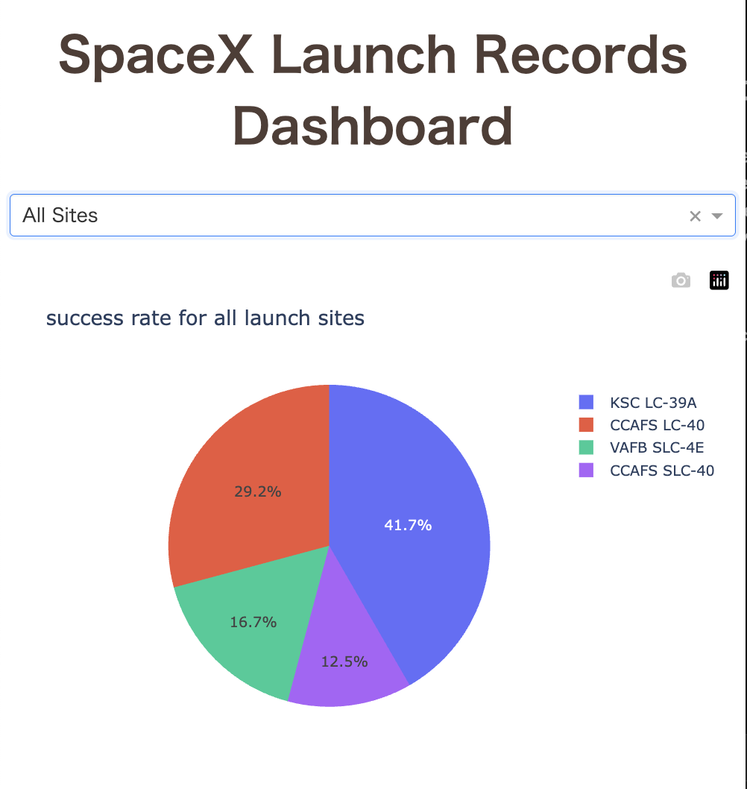
Success rate for all launch site
Visualize launch success rate for each launch site using the Plotly Dash application

Slide 44
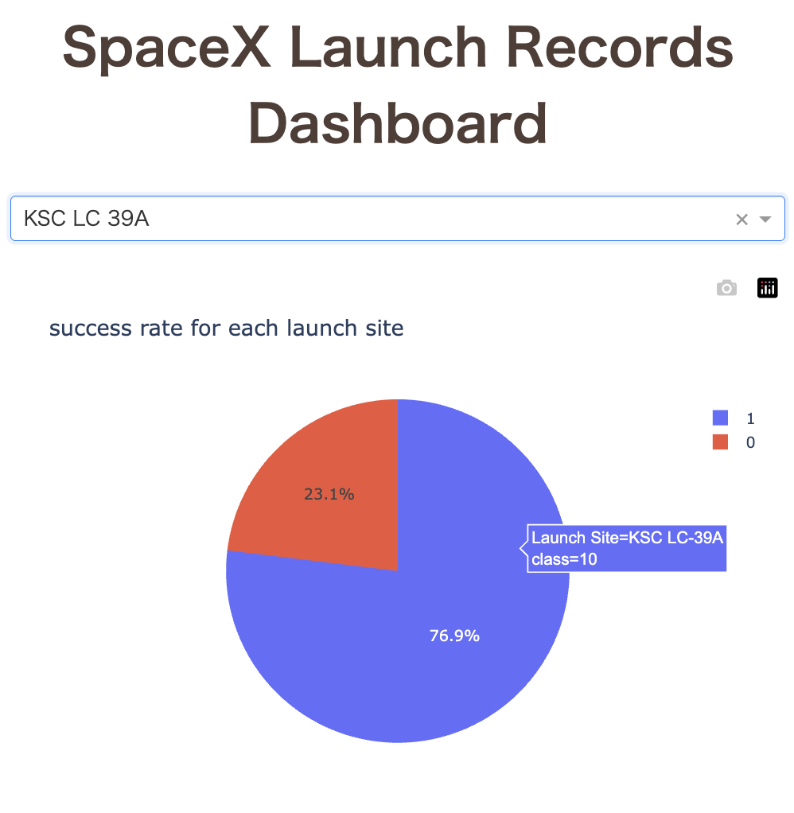
The most successful launch site
The launch site with the highest success rate was Launch Complex 39 (LC-39) at the John F. Kennedy Space Center in Merritt Island, Florida

Slide 45
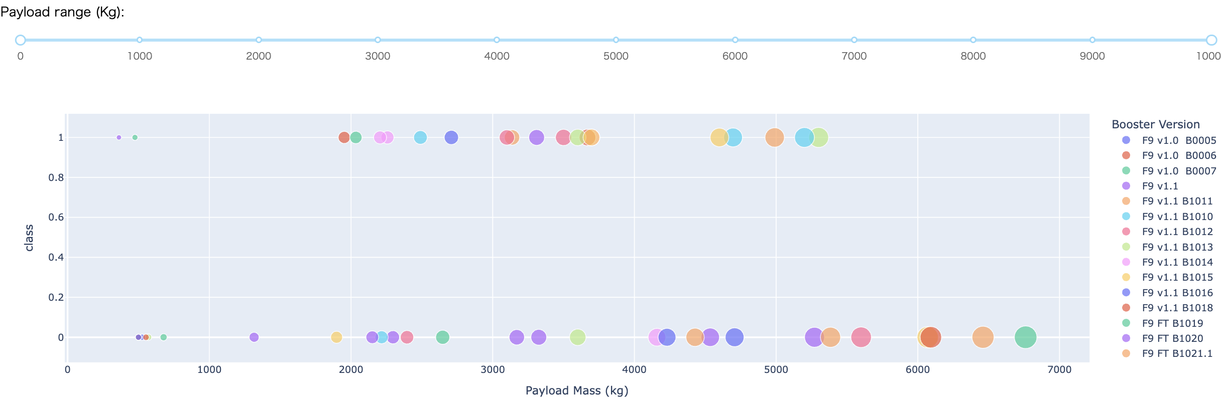
Payload and launch results
The success rate of launch decreases when the payload exceeds 5000 kg
If the payload exceeds 6000kg, the launch will fail
The FT version has the highest success rate among boosters with more than 10 launches

Slide 46

Section 5

Slide 47
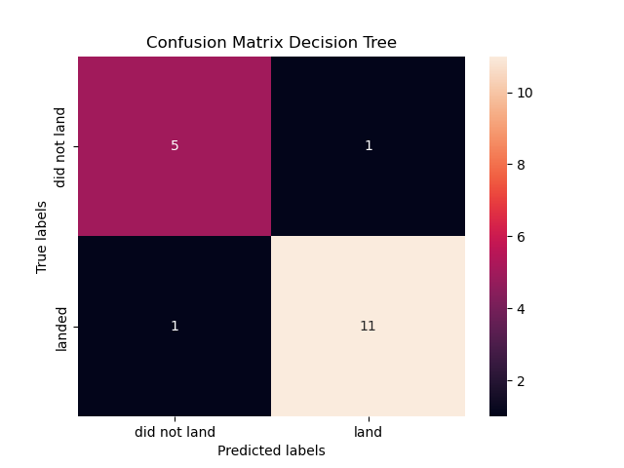
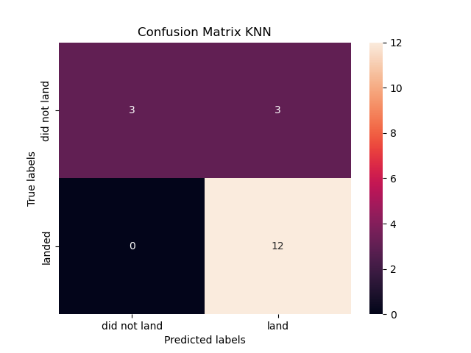


Classification Accuracy
The most accurate model in the training dataset was Decision Tree
On the other hand, there was no difference in accuracy when looking at the test scores.

Slide 48

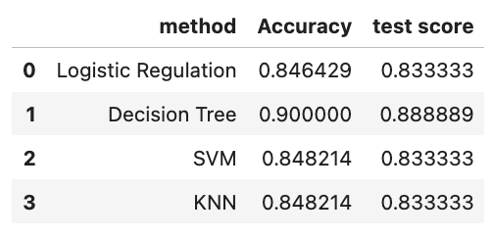
Confusion Matrix
Confusion matrix of Decision Tree model
The classification accuracy details are shown in the table below
 | precision | recall | f1-score | support
0 | 1.00 | 0.50 | 0.67 | 6
1 | 0.80 | 1.00 | 0.89 | 12
accuracy |  |  | 0.83 | 18
macro avg | 0.90 | 0.75 | 0.78 | 18
weighted avg | 0.87 | 0.83 | 0.81 | 18

Slide 49
Conclusions
The most successful orbit types are SSO and HEO and GEO and ES-L1
The launch site with the highest success rate was KSC LC-39
Comparing the payload and launch results axes, the success rate of launch decreases when the payload exceeds 5000 kg
The overall success rate of launches is improving year by year.

Slide 50
Appendix
Include any relevant assets like Python code snippets, SQL queries, charts, Notebook outputs, or data sets that you may have created during this project

Slide 51


